Slide 1


Thermal Analysis of Heat Distribution in Compressor Cylinder Fins
SYED SAQIB AHMED 4VV19ME137
MOHAMMED FARHAN M A 4VV20ME424
THUSHAR K NIMBALKAR 4VV19ME140
SUMANTH .B 4VV19ME132
UNDER THE GUIDANCE OF
Prof. MUTHURAJ.N.P

Slide 2
Introduction to solid fins
Fins are the extended surfaces used for increasing the heat transfer to or from the environment
The amount of conduction, convection, or radiation of an object determines the amount of heat it transfers.
Increasing the temperature gradient between the object and the environment, increasing the convection heat transfer coefficient, or increasing the surface area of the object increases the heat transfer.
Sometimes it is not feasible or economical to change the first two options

Slide 3
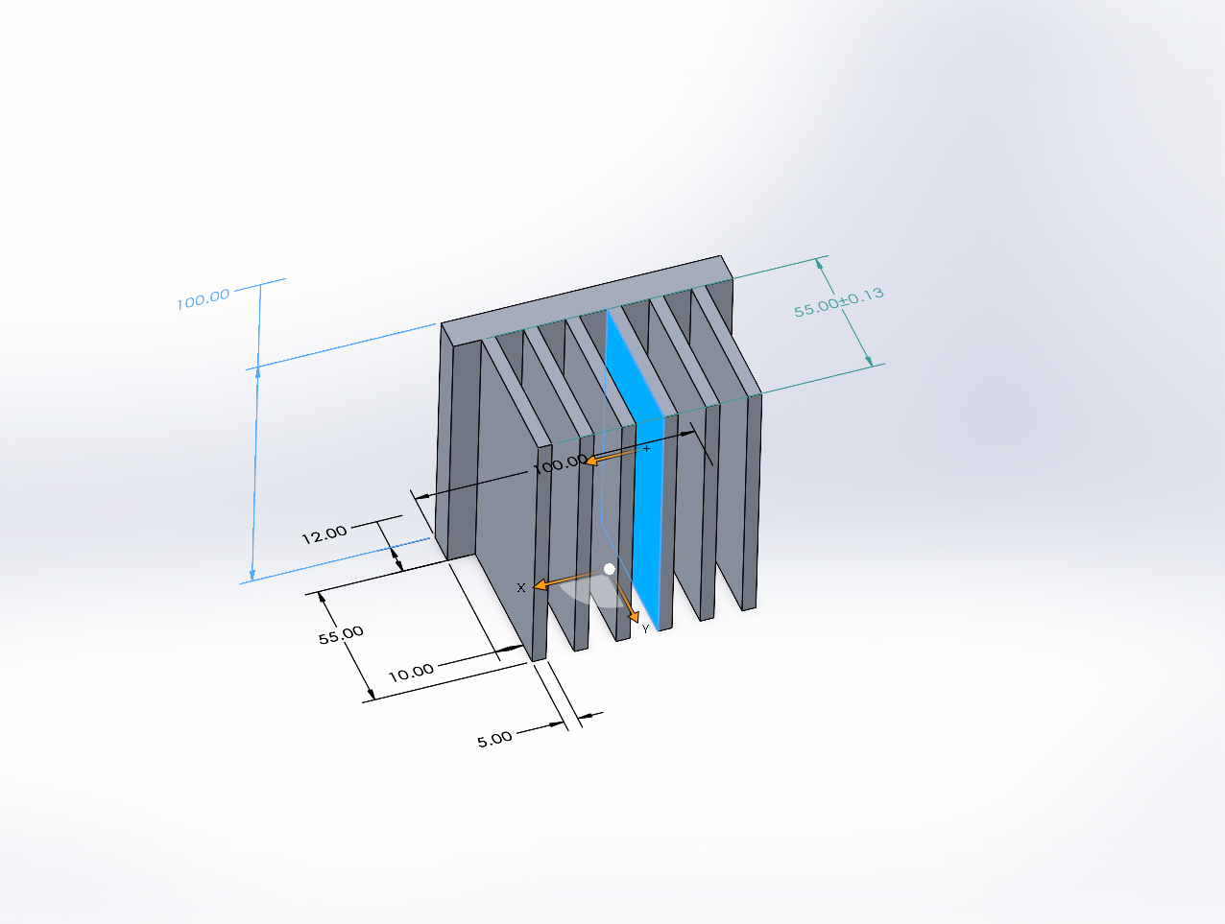
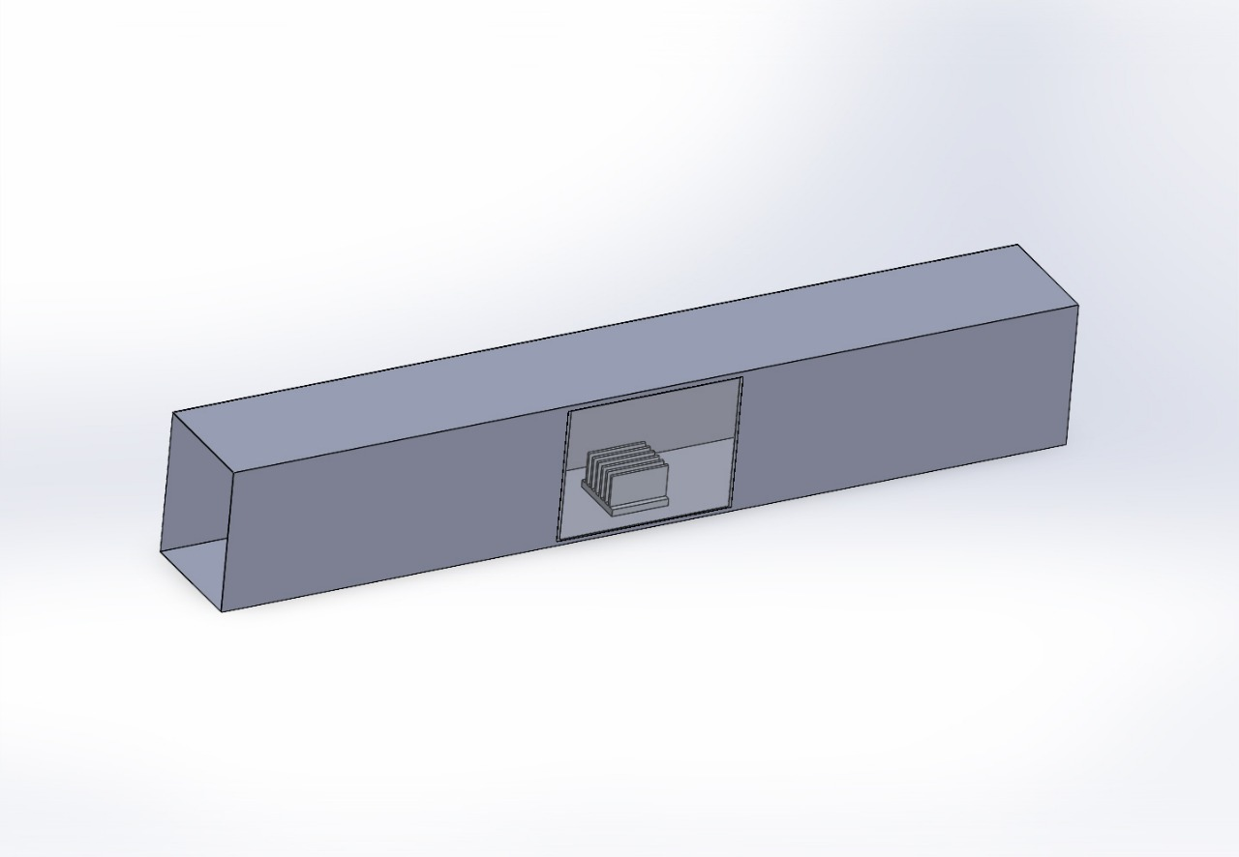
PROPOSED SKETCH

Slide 4
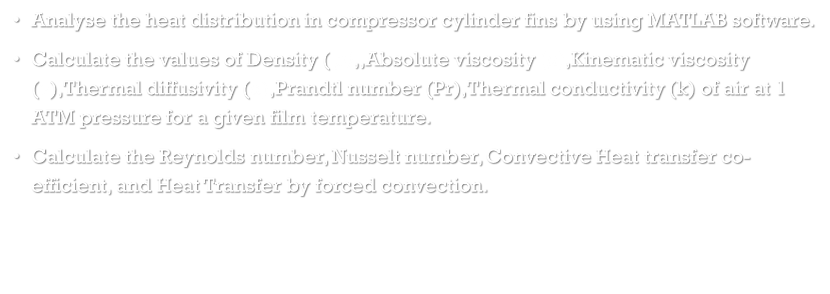
PROBLEM STATEMENT
Analyse the heat distribution in compressor cylinder fins by using MATLAB software.
Calculate the values of Density ( ρ),,Absolute viscosity (μ),Kinematic viscosity ($ν$),Thermal diffusivity (α),Prandtl number (Pr),Thermal conductivity (k) of air at 1 ATM pressure for a given film temperature.
Calculate the Reynolds number, Nusselt number, Convective Heat transfer co-efficient, and Heat Transfer by forced convection.

Slide 5
Objectives
Learn the rate of heat transfer through fin by forced convection.
Learn and use of MATLAB software.

Slide 6
Scope of project
The scope of this project is

Slide 7
Methodology
Taking the experimental readings of aluminium solid fin for varying velocity.
Getting the correlations for air properties with respect to film temperature.
Writing a program in MATLAB to find various parameters and temperature distribution over the fin.
Validating the theoretical temperature with the experimental value.
Plot the graphs of results obtained.

Slide 8
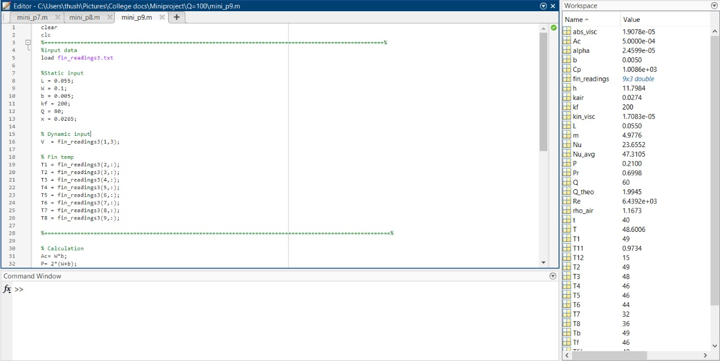
Numerical analysis

Slide 9

Theoretical Calculations
T_{f} =$\frac{(T3+T4+T5+T6)}{4}$
T_{infi}= $\frac{T_{7}+T_{8}}{2}$
T_{m}=$\frac{T_{f+}T_{infi}}{2}$
T_{b}=$\frac{T_{1}+T_{2}}{2}$
R_{e}=$\frac{V∗L}{ν}$
N_{u} =0.332 $R_{e}^{0.5}$ ${\text{Pr} }^{0.333}$

Slide 10

h=$\frac{N_{u}∗k}{L}$
Q=(${\text{hPkA}\text{)}}^{0.5}$*(T_{b}+T_{infi})*tanh(mL)
m=$\sqrt{\frac{h∗P}{k∗A}}$
$\frac{\text{T}−\text{T}\text{infi}}{\text{T}\text{b}\text{-}\text{T}\text{infi} }$=$\frac{\text{c}\text{oshm}\text{(}\text{L}\text{-}\text{x}\text{)}}{\text{c}\text{osh}\text{(}\text{mL}\text{)}}$

Slide 11
REFERENCES
Forced Convection Heat Transfer through the Rectangular Fins of Different Geometry of Perforations by Dr. B.B.Ganesha, Dr.GVN Prakash
Thermal Analysis of Compressor Cylinder Fins By, Bade Yellaji, Dr. D Sriramulu, S. Krishna Madhavi
Design and Analysis of Cooling Fins of Engine By, Akashnil Kayal, Arijit Sur
Modelling and Thermal Analysis On Cylinder Fins By, G. Ashok Kumar, K. Yathish , B. Prasanna Kumar Reddy, P. Dheeraj Kumar, A. Harinath

